Slide 1



Slide 2

BUSINESS ANALYTICS Introduction to Business Analytics and Core Business Functions
BUSINESS ANALYSIS Requirements Engineering
Basics

Slide 3

Learning Objectives – WEEK 4
By the end of today you should be able to:
Differentiate Business, Functional, and Non-Functional requirements
Understand the Requirements Lifecycle
Identify high-quality requirements
Think like a real Business Analyst during requirement discovery

Slide 4
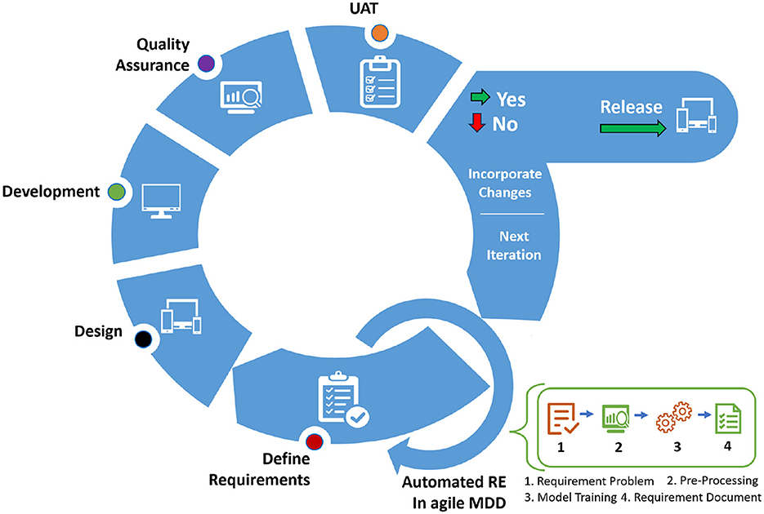
WHAT ARE REQUIREMENTS?
A requirement is what the business needs the system to do.
Requirements are NOT:
❌ Features guessed by developers
❌ Ideas from one stakeholder
Requirements ARE:
✔ Business needs
✔ User expectations
✔ System constraints
Example
Careem Ride Booking
Business Need: Increase ride bookings.
Requirement: User can book ride in less than 3 clicks.
Netflix
Business Need: Reduce churn.
Requirement: System recommends personalized content.

Slide 5
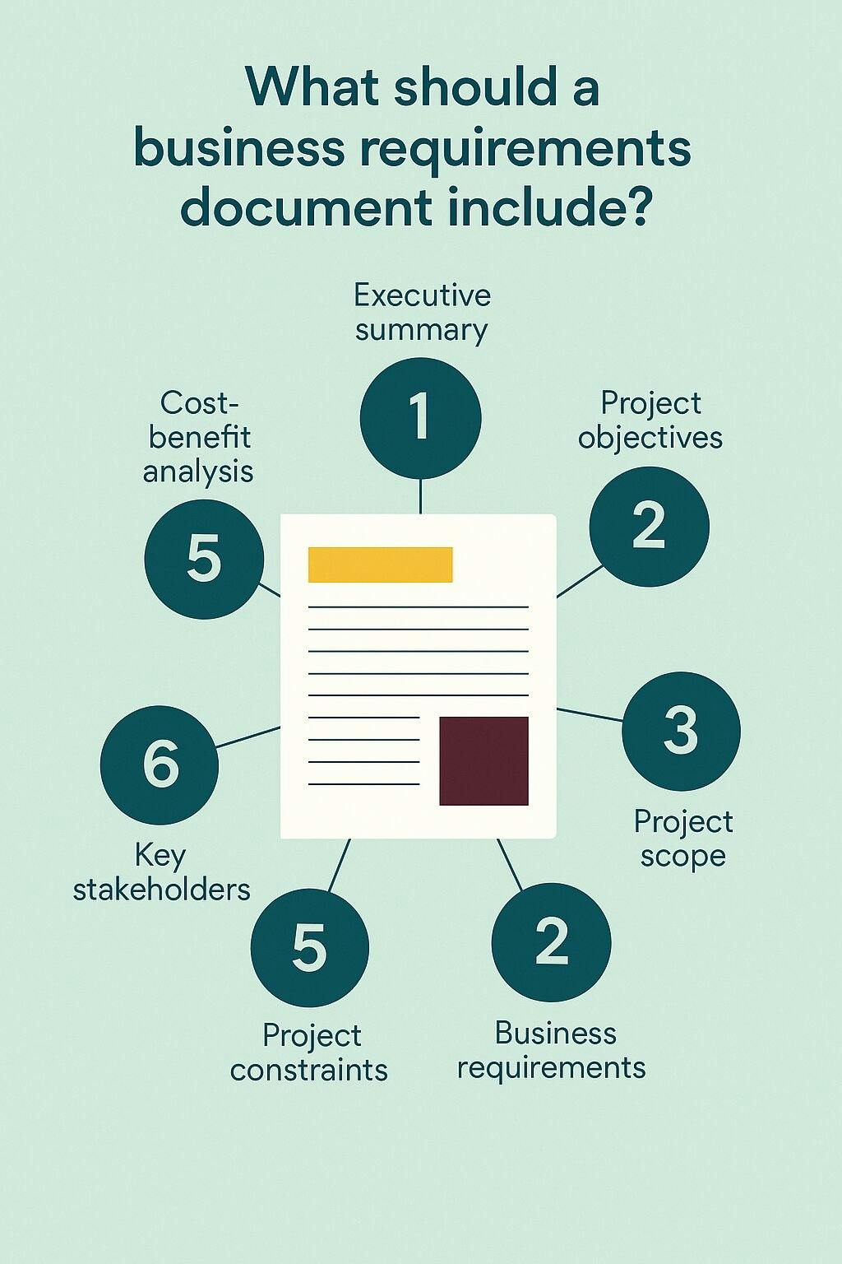

Slide 6
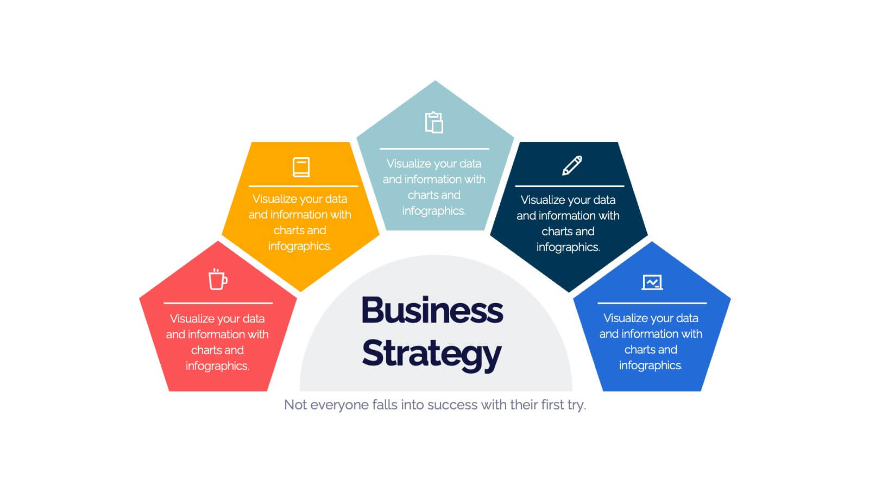
TYPES OF REQUIREMENTS
Most beginner BAs confuse these — but industry separates them clearly
🟢 Business Requirements (WHY)
High-level goals from business perspective.
Examples:
Pakistan:
Bank wants to increase digital transactions by 30%.
International:
Amazon wants faster checkout experience.
Key Question: 👉 Why are we building this?

Slide 7
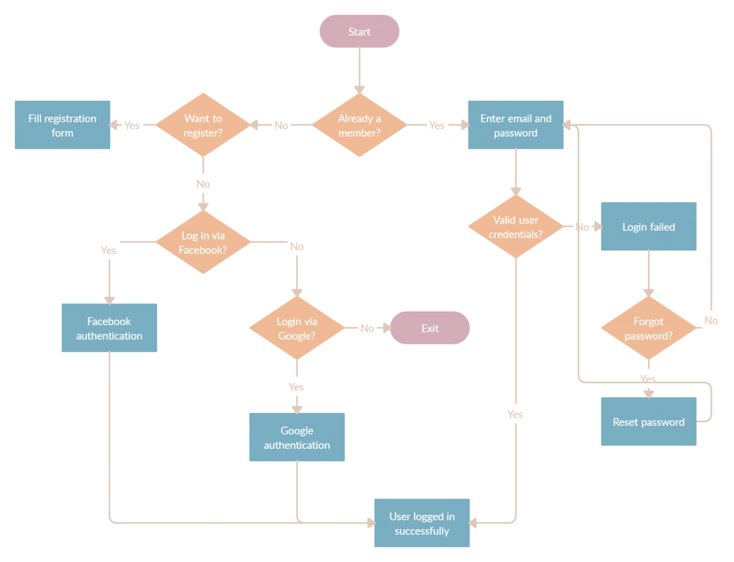
TYPES OF REQUIREMENTS
Most beginner BAs confuse these — but industry separates them clearly
🔵 Functional Requirements (WHAT SYSTEM DOES)
System behaviours or features.
Examples:
Pakistan:
User can transfer money via JazzCash.
Customer can add property in real estate CRM.
International:
Uber calculates fare automatically.
Format Example:
“System shall allow user to login using email.”

Slide 8
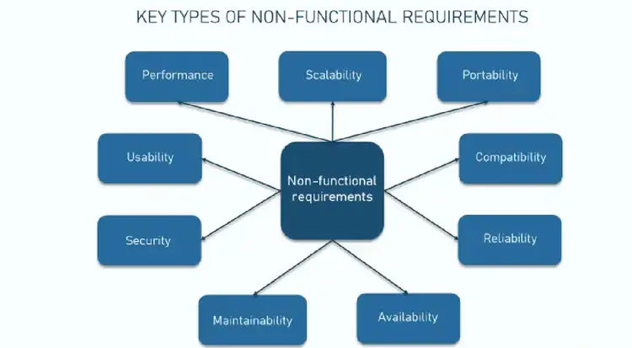
TYPES OF REQUIREMENTS
🟣 Non-Functional Requirements (HOW WELL SYSTEM WORKS)
Quality attributes.
Examples:
Type | Example
Performance | Page loads in < 2 seconds
Security | OTP authentication
Usability | Mobile responsive
Availability | 99.9% uptime
Pakistan Example: NADRA portal must handle high traffic securely.
International Example: PayPal requires high security standards.

Slide 9
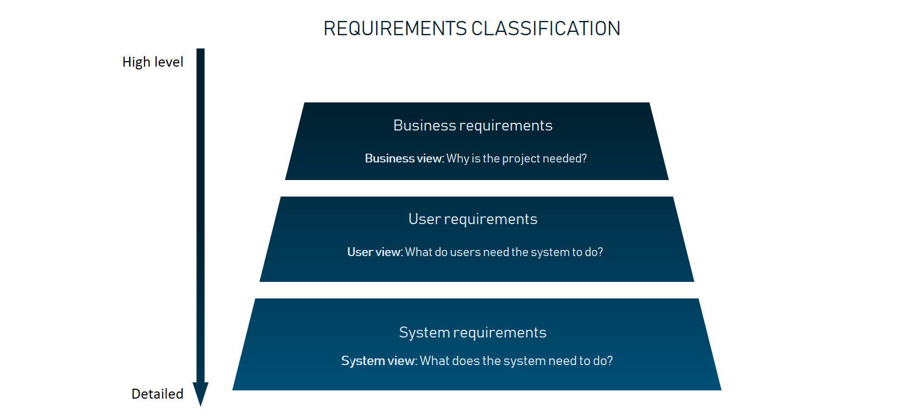
TYPES OF REQUIREMENTS

Slide 10
REQUIREMENTS LIFECYCLE
Elicit → Analyze → Document → Validate → Manage
🟠 Elicitation
Gather requirements.
Example: BA interviews Careem operations team.
🟡 Analysis
Understand feasibility.
Example: Developer says feature needs API integration.
🟢 Documentation
Write requirements clearly.
Example: BRD, User Stories (coming in Week 6).
🟣 Management
Handle changes.
Example: Client requests UI change mid-project.
🔵 Validation
Confirm with stakeholders.
Example: Client signs off feature scope.

Slide 11
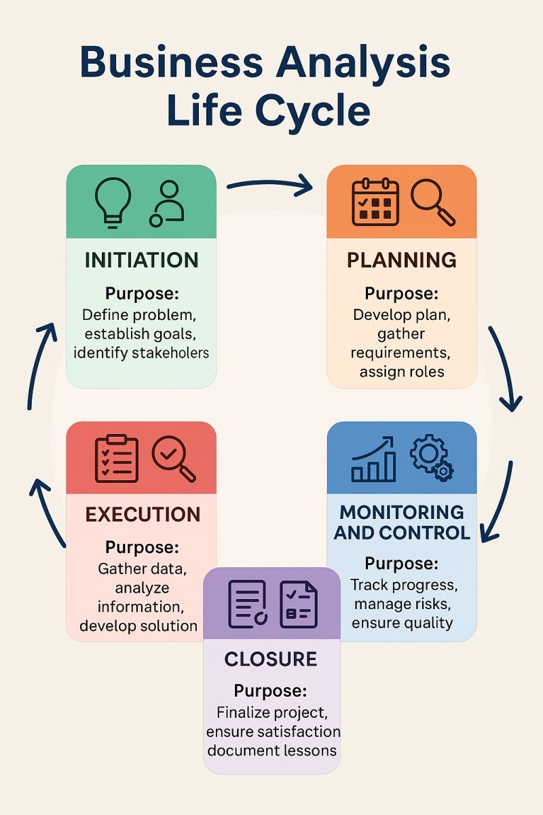
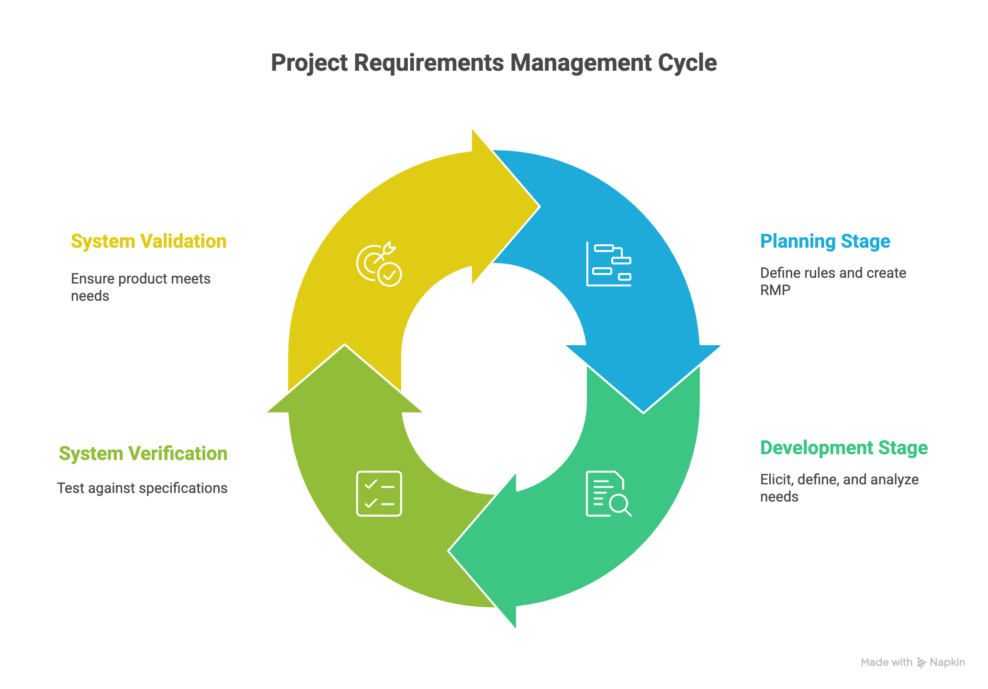
REQUIREMENTS LIFECYCLE

Slide 12
CHARACTERISTICS OF GOOD REQUIREMENTS (QUALITY STANDARDS)
A good requirement must be:
✔ Clear ✔ Testable ✔ Measurable ✔ Feasible ✔ Unambiguous
🔴 Bad Requirement Example
“System should be fast.”
Ask students:
👉 “What does fast mean?”
This teaches ambiguity.
🟢 Good Requirement Example
“System should load dashboard within 2 seconds for 1,000 concurrent users.”

Slide 13
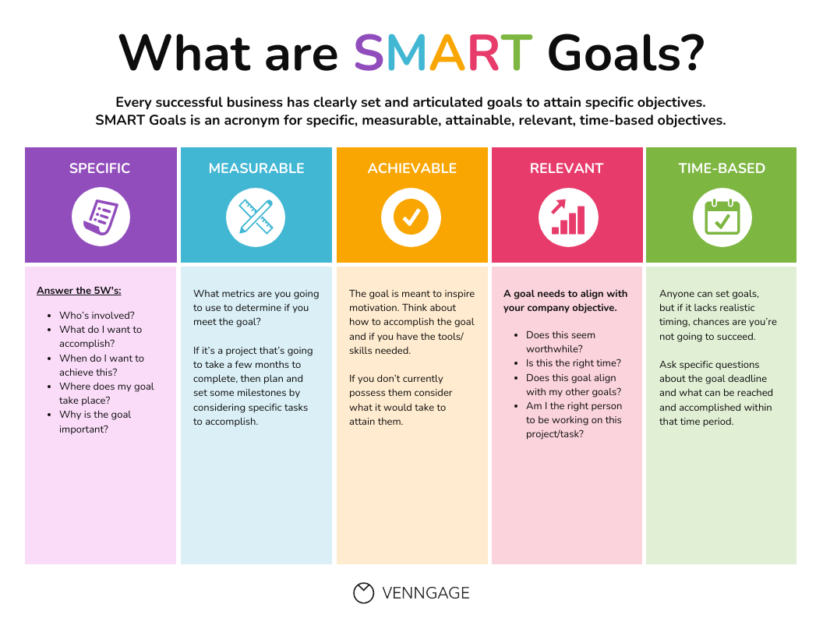
CHARACTERISTICS OF GOOD REQUIREMENTS (QUALITY STANDARDS)

Slide 14
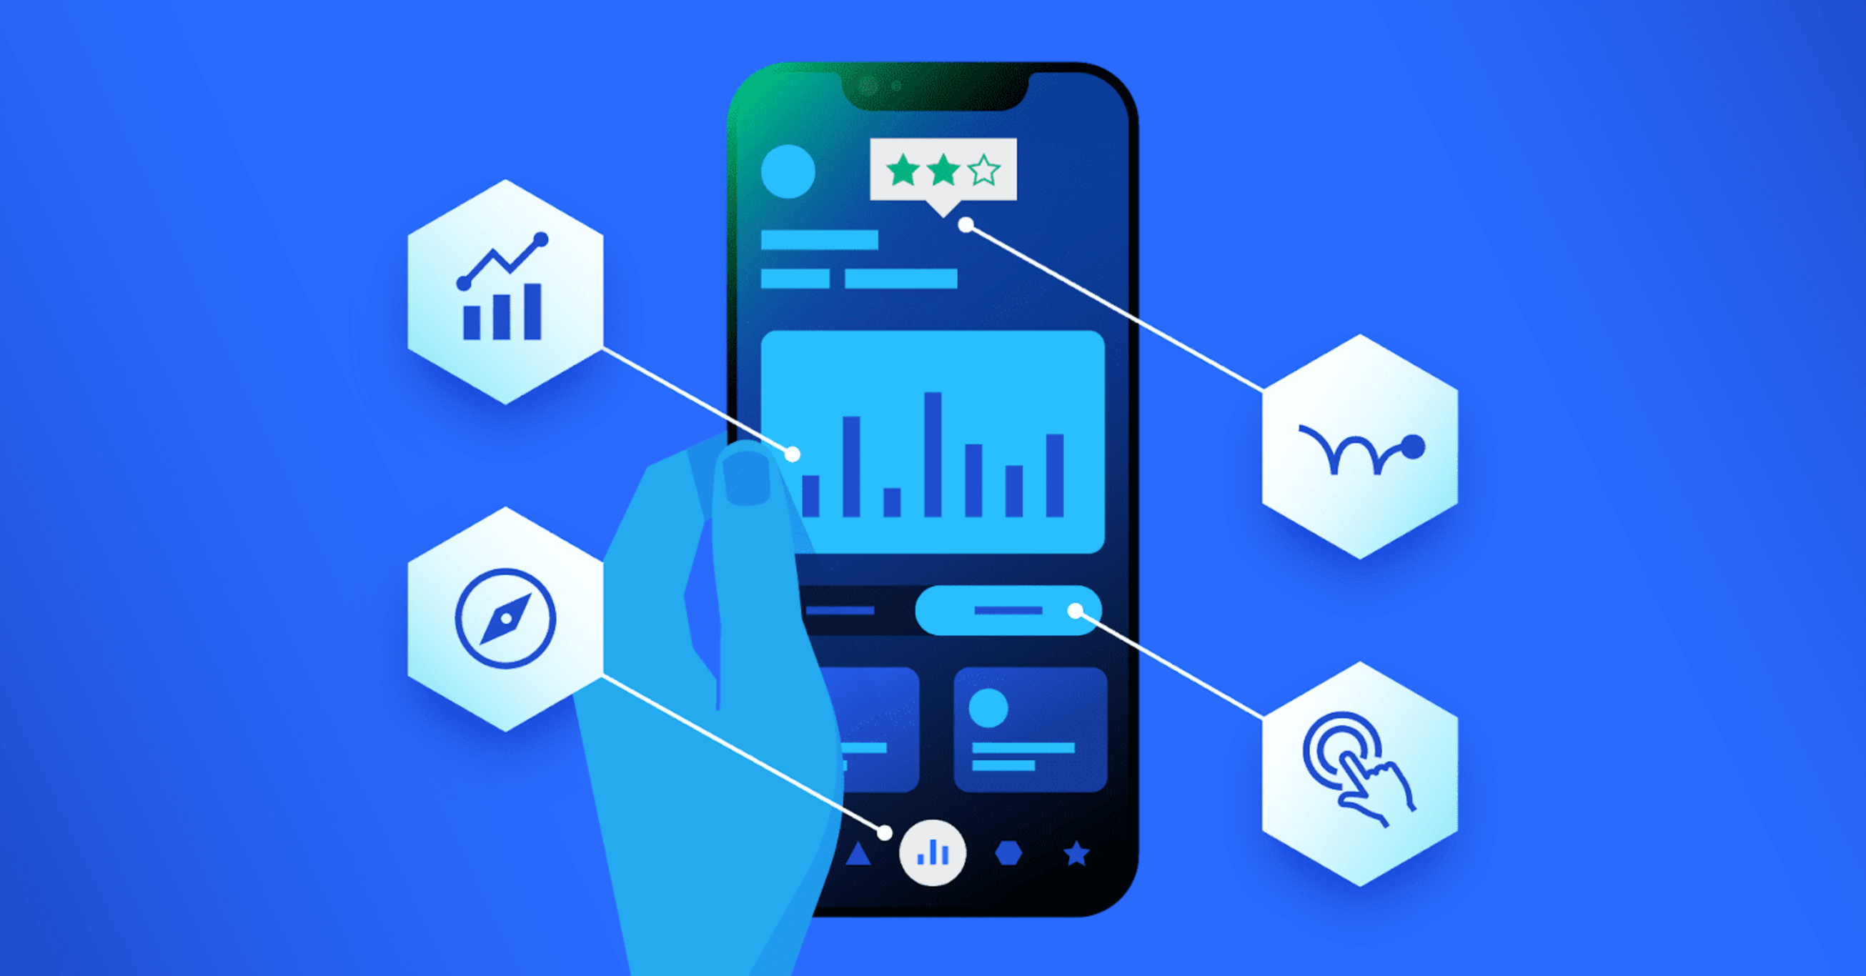
REAL INDUSTRY SCENARIO
Pakistan Case – Fintech App
Client says:
“Make app more user-friendly.”
BA must convert into:
Functional:
Add quick transfer button.
Non-Functional:
Reduce loading time to 1.5 seconds.
Lesson: BA translates vague ideas into precise requirements.
International Case – Spotify
Requirement:
Functional:
User can create playlist.
Non-Functional:
Playlist sync across devices instantly.

Slide 15
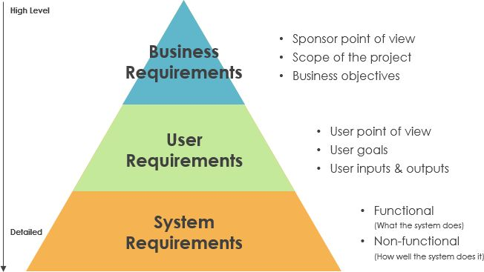
REQUIREMENT PYRAMID
Business drives functional → Functional defines system → Non-functional defines quality.

Slide 16
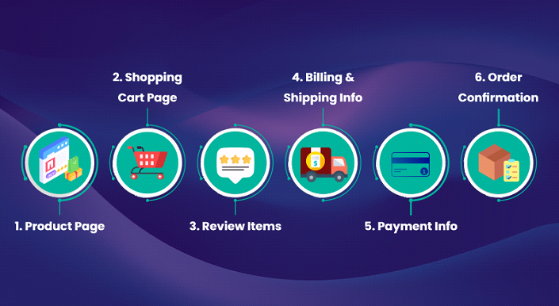
MINI CASE STUDY (INTERACTIVE DISCUSSION)
Scenario:
Daraz wants to improve checkout experience.
What are the
Business requirement?
Functional requirement?
Non-functional requirement?
Notes:
A very important concept:
Business Problem answers: WHAT is going wrong? WHY is it happening?
Technical Problem answers: HOW will we fix it using technology?

Slide 17
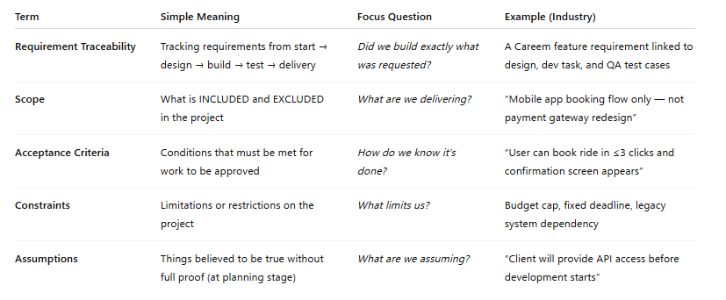
KEY TERMINOLOGY STUDENTS MUST LEARN

